Slide 1
Design Grammars for Creative Programmers
Adam M. Smith
TESC. November 19, 2013

Slide 2
Programming as a way of life

Slide 3
Design Grammars
Little programming languages for expressing patterns
ContextFreeArt – generative 2D visuals
StructureSynth – generative 3D visuals
CFML – generative music

Slide 4
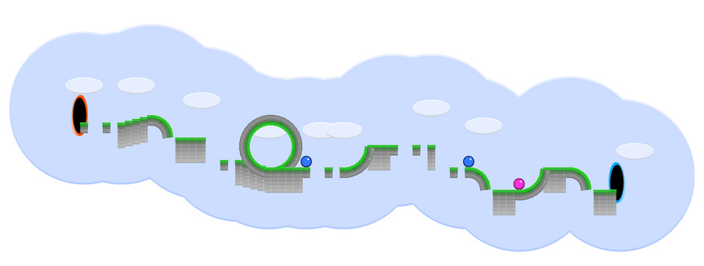

Slide 5



Slide 6
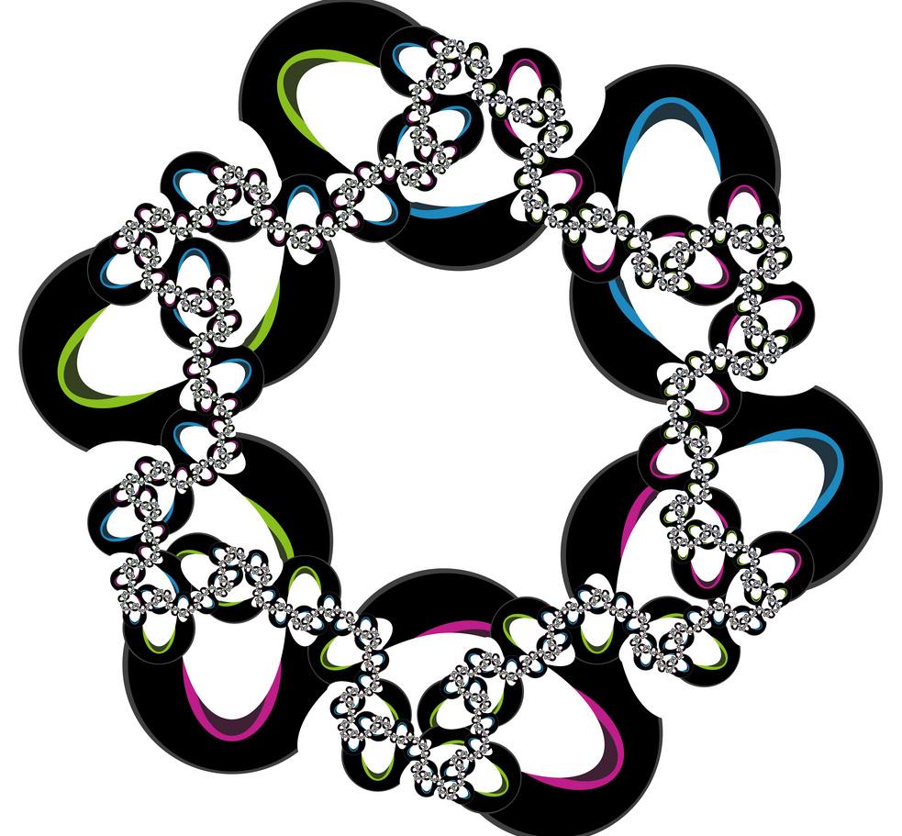

Slide 7
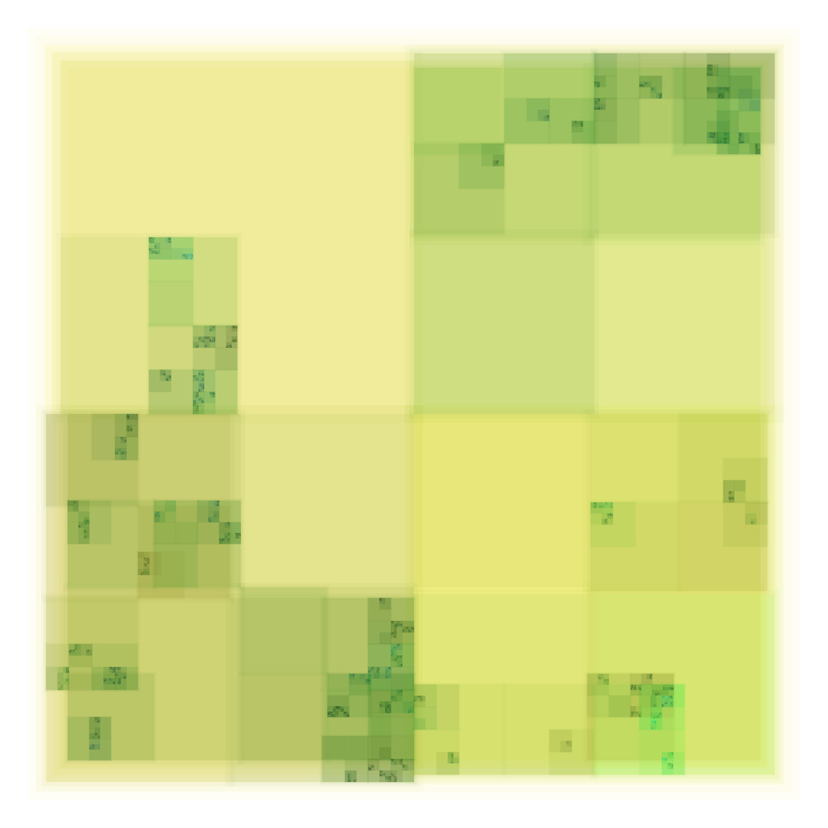

Slide 8
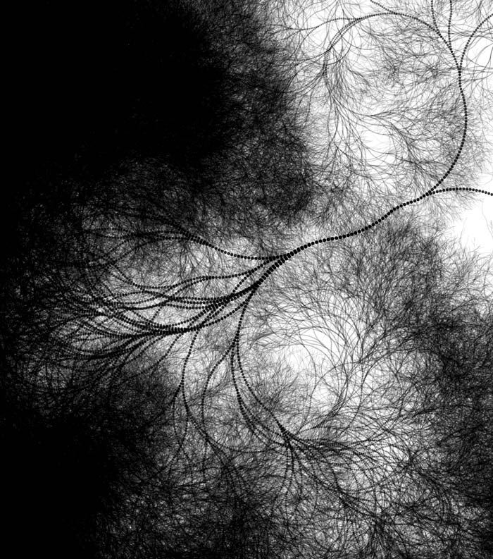

Slide 9
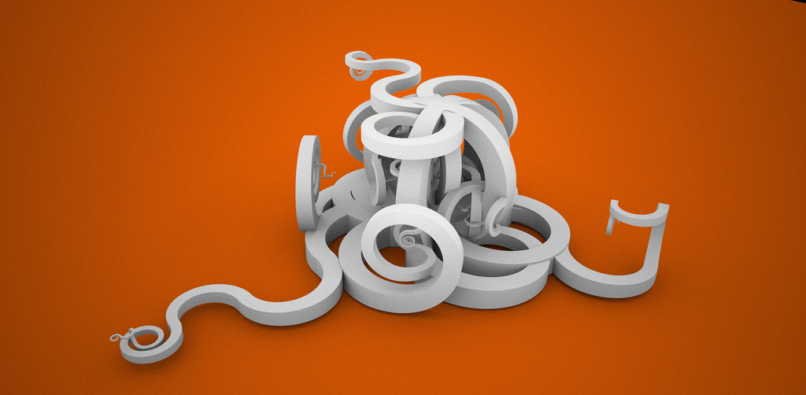

Slide 10
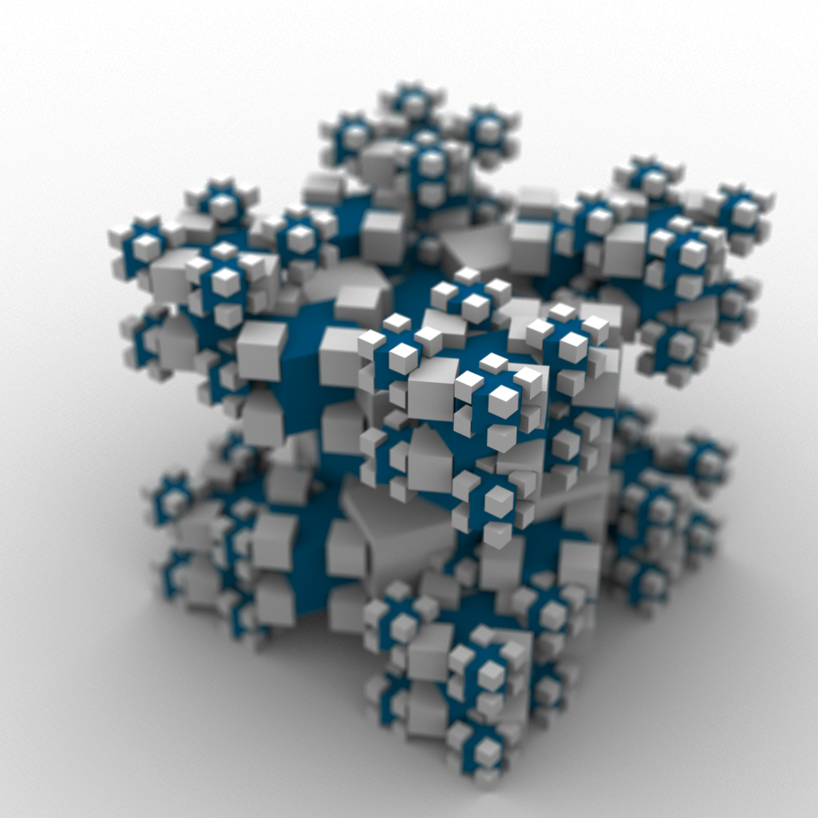

Slide 11
Vocabulary
Primitives
Transformations
Abstractions
Nondeterminism

Slide 12
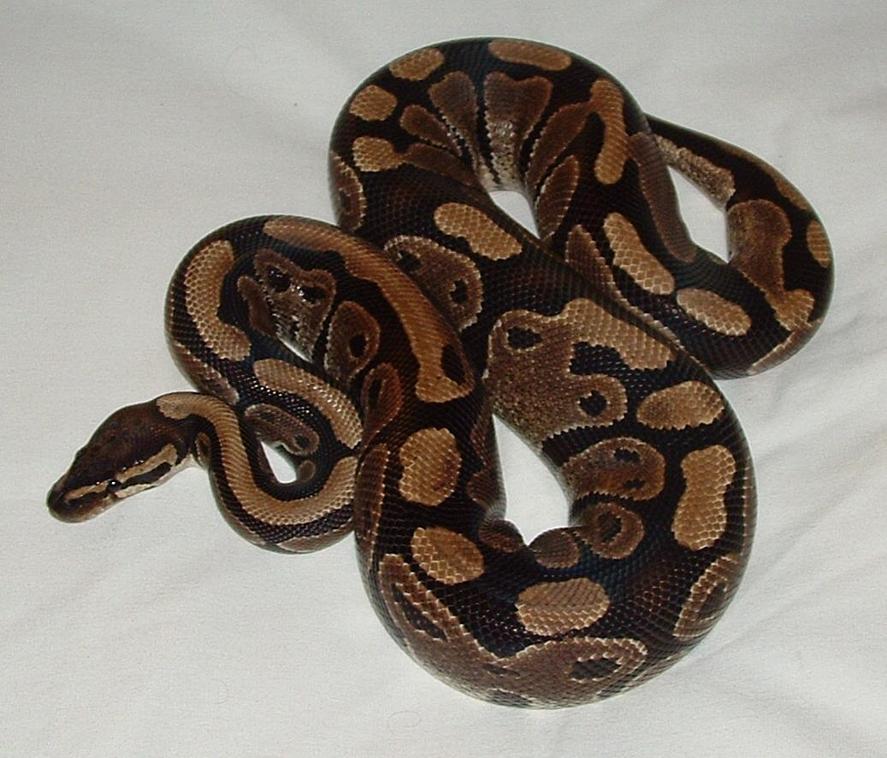
Python

Slide 13
Some Snakes
____
________________________/ O \___/
<_____________________________/ \
____
____________________/ O \___/
<_/_\_/_\_/_\_/_\_/_______/ \
____
________________________________/ O \___/
<%%%%%%%%%%%%%%%%%%%%%%%%%%%%%%%%_____/ \
____
______________/ O \___/
<_O_O_O_O_O_O_O_____/ \
____
________________________________/ O \___/
<_8_8_8_8_8_8_8_8_8_8_8_8_8_8_8_8_____/ \
____
________________________/ O \___/
<888888888888888888888888_____/ \
____
________________________________/ O \___/
<%%%%%%%%%%%%%%%%%%%%%%%%%%%%%%%%_____/ \
body
head
tail
segment
eye
tongue

Slide 14
A Snake Recipe
Snake:
1 head
1 body
Head:
1 skull
2 eyes
1 tongue
Body: (common)
1 spine segment
1 body
Body: (uncommon)
1 tail

Slide 15
ContextFreeArt demo

Slide 16
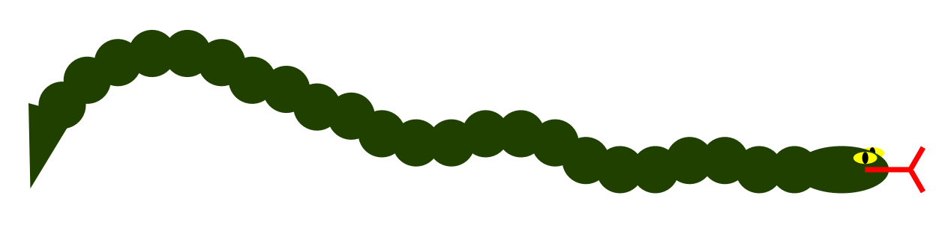
startshape snake
shape snake {
head []
body [z 1 x -1]
}
shape tongue {
SQUARE [s 1 0.1]
SQUARE [x 0.6 y 0.25 s 0.5 0.1 r 60]
SQUARE [x 0.6 y -0.25 s 0.5 0.1 r -60]
}
shape eye {
CIRCLE [b 1 sat 1 hue 60]
CIRCLE [b 0 s 0.25 1]
}
shape head {
CIRCLE [s 2 1 b 0.25 sat 1 hue 90]
eye [x 0.5 y 0.25 s 0.5 0.25]
eye [x 0.65 y 0.35 s 0.5 0.25 z -1]
tongue [x 1 b 1 sat 1]
}
shape body
rule 6 {
segment []
body [x -0.75 r 15]
}
rule 4 {
segment []
body [x -0.75 r -15]
}
rule 0.5 {
tail []
}
shape segment {
CIRCLE [ b 0.25 sat 1 hue 90]
}
shape tail {
TRIANGLE [r 90 s 1 2 b 0.25 sat 1 hue 90]
}

Slide 17
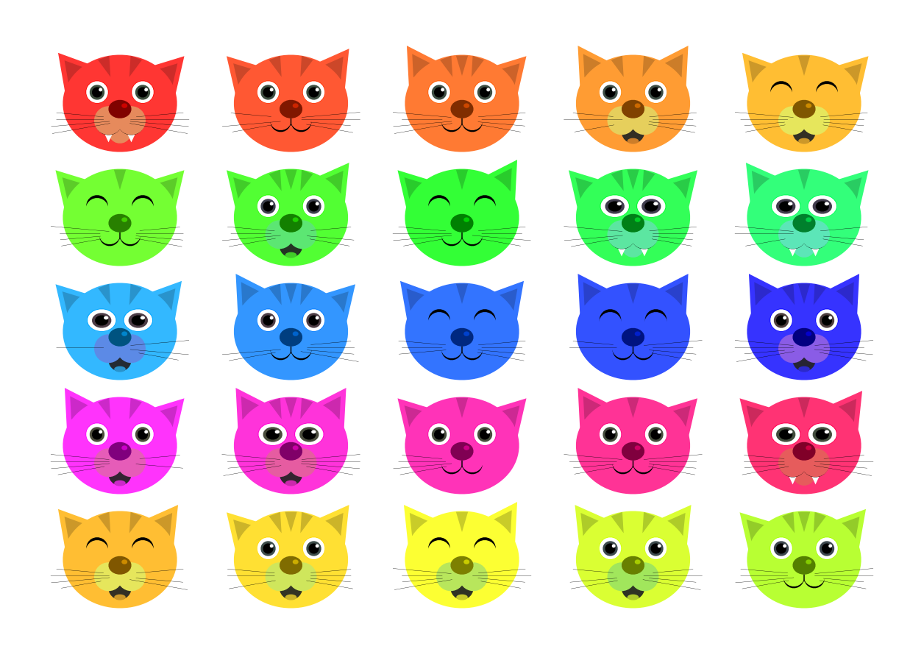
startshape cats
rule cats {
5 * { hue +10 x +150 sat 0} {
5 * { hue +100 y - 100 } cat { }
}
}
rule cat {
head {}
eyes {}
ears {}
stripes {}
nose {}
}
rule head {
CIRCLE { s 100 85 hue 1 sat 0.8 b 1 z -10}
}
rule eyes { eye { x 20 } eye { x -20 } }
rule eyes { happyeye { x 20 } happyeye { x -20 } }
rule eyes { eye { s 1.3 1 x 16 } eye { s 1.3 1 x -16 } }
#rule eyes { cateye { x 20 } cateye { x -20 } }
rule happyeye {
CIRCLE { s 19 y 10 }
CIRCLE { s 20 y 7 hue 1 sat 0.8 b 1 }
}
rule cateye {
CIRCLE { s 19 y 10 hue 1 sat 1 b 1}
CIRCLE { s 18 y 10 hue 120 sat 0.1 b 1}
CIRCLE { s 5 14 y 10 }
}
rule eye {
CIRCLE { s 20 y 10 hue 1 sat 1 b 1}
CIRCLE { s 19 y 9.9 sat 0 b 1 }
CIRCLE { s 13 y 9.7 hue 120 sat 0.2 b 0.3 }
CIRCLE { s 9 y 9.7 }
CIRCLE { s 3 y 12 x 3 sat 0 b 1 }
}
rule ears { ear { } ear { flip 90 } }
rule ear { triear { r 2 } }
rule ear { triear { r -2 } }
rule ear { triear { r 5 } }
rule ear { triear { r -5 } }
rule triear {
TRIANGLE { s 35 x -40 y 30 r 38 z -11 hue 1 sat 0.8 b 1}
TRIANGLE { s 20 x -40 y 30 r 38 z -11 hue 1 sat 0.8 b 0.8}
}
rule stripes { stripe { r 20 y +0.5} stripe { r 0 } stripe { r -20 y +0.5} }
rule stripes { stripe { r 20 y +0.5} stripe { r -20 y +0.5} }
rule stripes { stripe { r 0 } }
rule stripe {
TRIANGLE { s 10 20 y 36 r 180 hue 1 sat 0.8 b 0.8 }
}
rule nose 0.5 {
CIRCLE { s 20 16 y -5 h 1 sat 1 b 0.5 }
CIRCLE { s 5 4 y -2 x 4 h 1 sat 1 b 0.8 }
SQUARE { s 0.8 6 y -16 z -1 }
CIRCLE { x -9 s 18 y -16 z -2 }
CIRCLE { x -9 s 19 y -14 z -2 hue 1 sat 0.8 b 1 }
CIRCLE { x 9 s 18 y -16 z -2 }
CIRCLE { x 9 s 19 y -14 z -2 hue 1 sat 0.8 b 1 }
whiskers { }
}
rule nose {
CIRCLE { s 20 16 y -5 h 1 sat 1 b 0.5 }
CIRCLE { s 5 4 y -2 x 4 h 1 sat 1 b 0.8 }
CIRCLE { s 25 z -8 y -15 hue 20 sat 0.6 b 0.9 x 10 }
CIRCLE { s 25 z -8 y -15 hue 20 sat 0.6 b 0.9 x -10 }
whiskers {}
mouth { }
}
rule whiskers { half_whiskers {} half_whiskers { flip 90 } }
rule half_whiskers { 4 * { r -5 y -1 x +1 } whisker { r -85 x 35 y -10 } }
rule whisker { SQUARE { s 0.2 35 } }
rule whisker { SQUARE { s 0.2 51 } }
rule whisker { SQUARE { s 0.2 41 } }
rule whisker 0.4 { }
rule mouth {
CIRCLE { s 20 y -25 z -9 hue 10 sat 0.3 b 0.2}
CIRCLE { s 10 5 y -33 x 0 hue 1 sat 0.8 b 0.8}
}
rule mouth { # teeth
CIRCLE { s 24 z -9 y -15.7 x -9.9 }
CIRCLE { s 24 z -9 y -15.7 x 9.9 }
TRIANGLE { s 8 10 r 180 y -28 z -9.8 x -10 b 1 sat 0}
TRIANGLE { s 8 10 r 180 y -28 z -9.8 x 10 b 1 sat 0 }
CIRCLE { s 20 y -25 z -9.9 hue 20 sat 0.6 b 0.9}
}

Slide 18

startshape CityRoot
import i_pix.cfdg
shape Mouth {
SyllableBoth []
}
shape Syllable
rule 10 { Consonant [] }
rule 1 { SyllableLeft [] }
rule 5 { SyllableBoth [] }
rule 1 { SyllableRight[] }
shape SyllableLeft {
Consonant []
Vowel [x 1.2]
Syllable [x 2.4]
}
shape SyllableBoth {
Consonant []
Vowel [ x 1.2 ]
Consonant [ x 2.4 ]
SyllableRight [ x 3.6 ]
}
shape SyllableRight {
Vowel []
Consonant [ x 1.2 ]
Syllable [ x 2.4 ]
}
shape Vowel
rule 8.2 { A_5by5 [] }
rule 12.7 { E_5by5 [] }
rule 0.2 { I_5by5 [] }
rule 7.5 { O_5by5 [] }
rule 2.8 { U_5by5 [] }
shape Consonant
rule 1.5 { B_5by5 [] }
rule 2.8 { C_5by5 [] }
rule 4.3 { D_5by5 [] }
rule 2.2 { F_5by5 [] }
rule 2.0 { G_5by5 [] }
rule 6.1 { H_5by5 [] }
rule 0.2 { J_5by5 [] }
rule 0.8 { K_5by5 [] }
rule 4.0 { L_5by5 [] }
rule 2.4 { M_5by5 [] }
rule 6.7 { N_5by5 [] }
rule 7.5 { P_5by5 [] }
rule 0.1 { Q_5by5 [] }
rule 6.0 { R_5by5 [] }
rule 6.3 { S_5by5 [] }
rule 9.1 { T_5by5 [] }
rule 1.0 { V_5by5 [] }
rule 0.2 { X_5by5 [] }
rule 2.0 { Y_5by5 [] }
rule 0.1 { Z_5by5 [] }
shape People
rule 1 {
SomePerson []
People [ y -2 ]
}
rule 1 {}
rule 5 {
People [ f 80 x 5 ]
}
shape SomePerson {
Person []
}
shape Person {
Head []
Torso []
Arm [y 0.2]
Arm [y 0.2 f 180 r 180]
Leg [y -0.4]
Leg [y -0.4 f 180 r 180]
}
shape Head {
CIRCLE [ s 0.2 y 0.4]
}
shape Torso
rule { TRIANGLE [ s 0.5 0.8] }
rule { SQUARE [ s 0.3 0.5] }
shape Arm
rule 1 { HalfArm [] }
rule 1 { HalfArm [ f 180 ] }
shape HalfArm
rule 1 {
SQUARE [ s 0.5 0.1 x 0.3]
}
rule 1 {
SQUARE [ s 0.3 0.1 x 0.1]
SQUARE [ s 0.2 0.1 x 0.3 y 0.1 r 45]
}
rule 1 {
SQUARE [ s 0.3 0.1 x 0.1 r 30]
SQUARE [ s 0.2 0.1 x 0.3 r 45 y 0.15]
}
shape Leg
rule { HalfLeg [] }
rule { HalfLeg [ f 180 ] }
shape HalfLeg
rule { SQUARE [ s 0.1 0.5 x 0.1 r 10] }
rule {
SQUARE [s 0.1 0.2 x 0.1 r 20 y 0.1]
SQUARE [s 0.1 0.3 x 0.1 r -10 y -0.1]
}
shape CityRoot {
CIRCLE [ s 100 b 0.25 y 25]
CitySpan []
CitySpan [f 90]
SQUARE [s 100 50 b 1 y -25 b 1]
Mouth [y -10 s 10 x 5 b 0.8]
}
shape CitySpan {
Building[]
CityNext[ s 0.965]
}
shape CityNext
rule { CitySpan [ x 1 ] }
rule { CitySpan [ x 5] }
shape Building
rule { Floor [ s 10 ] }
rule { Floor [ s 5 ] }
rule 0.5 { Segment [s 2] }
shape Floor
rule {
SQUARE [s 1 0.255]
SQUARE [s 0.15 0.2 x -0.4 b 1]
SQUARE [s 0.15 0.2 x -0.2 b 1]
SQUARE [s 0.15 0.2 b 1]
SQUARE [s 0.1 0.2 x 0.175 b 0.6]
SQUARE [s 0.1 0.2 x 0.3 b 0.6]
SQUARE [s 0.1 0.2 x 0.425 b 0.6]
Floor [y 0.25]
}
rule 0.1 { Roof [] }
rule 0.1 {
People [s 0.5 r 45]
Floor [x 0.25 y 0.125 r -10]
}
shape Roof
rule {
SQUARE [s 0.25 0.25]
SQUARE [s 0.1 0.25 x 0.4 ]
SQUARE [s 1 0.05 y -0.1 ]
}
rule 0.5 {
TRIANGLE [s 1 0.2 y -0.1]
TRIANGLE [s 0.1 2 y 0.5 ]
}
rule {
SQUARE [s 1 0.3]
SQUARE [s 0.5 0.2 x -0.2 b 1]
SQUARE [s 0.3 0.2 x 0.3 b 0.8]
}
shape Crane {
SQUARE [s 0.2 2 y 0.5]
SQUARE [s 0.5 0.5 y 0.2]
SQUARE [s 4 0.2 x 1 y 0.15]
CIRCLE [ s 0.33 x 3 y -4.75]
SQUARE [s 0.025 5 x 3 y -2.25]
SQUARE [s 0.025 1.5 r -35 x -0.5 y 0.75]
SQUARE [s 0.025 3.2 x 1.5 y 0.85 r 67]
}
shape Segment
rule {
SQUARE [s 0.05 1.3 r 45 y 0.5]
SQUARE [s 0.05 1.3 r -45 y 0.5]
SQUARE [s 1 0.05 y 0.025]
SQUARE [s 1 0.05 y 0.975]
SQUARE [s 0.05 1 x -0.475 y 0.5]
SQUARE [s 0.05 1 x 0.475 y 0.5]
Segment [y 1 s 0.995]
}
rule 0.05 { Crane[s 2] }

Slide 19
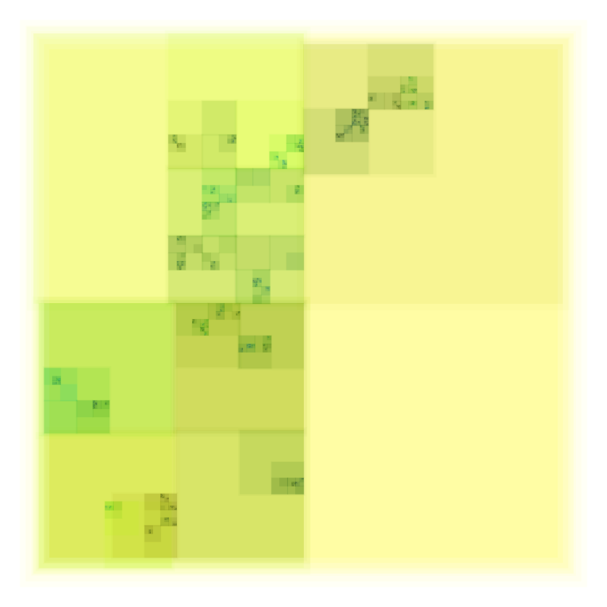
startshape Setup
tile { s 1.125}
rule Setup {
4*{s 0.98} Layer {a -0.9125 sat 1 hue 60 b 1}
}
rule Layer {
Glyph {}
Panel {x +0.25 y +0.25 s 0.5}
Panel {x -0.25 y +0.25 s 0.5}
Panel {x +0.25 y -0.25 s 0.5}
Panel {x -0.25 y -0.25 s 0.5}
}
rule Panel { Shift {} }
rule Panel { Shift {b -0.25} }
rule Shift { Recurse {hue 0} }
rule Shift { Recurse {hue 20 } }
rule Recurse 1.45 {}
rule Recurse { Layer {} }
rule Glyph {
SQUARE {}
SQUARE {s 1.05 a -0.5}
}

Slide 20
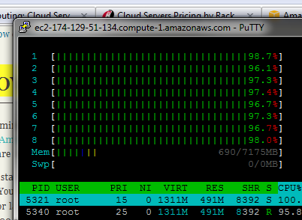

Slide 21
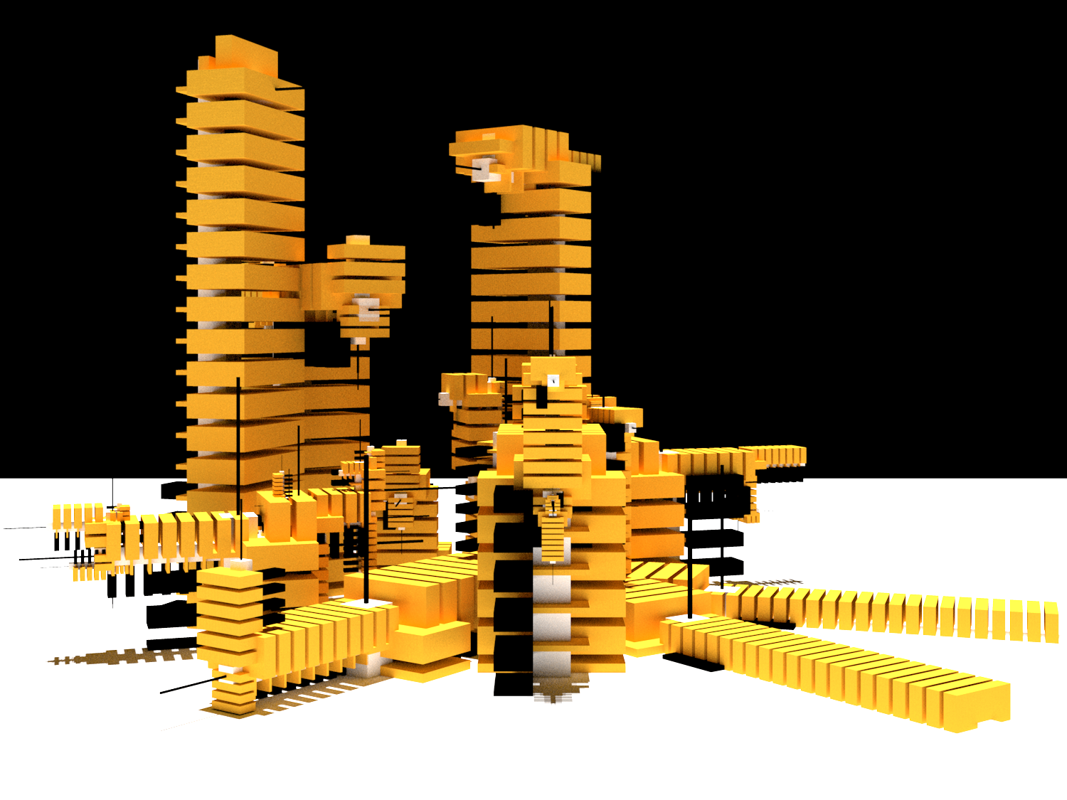

Slide 22
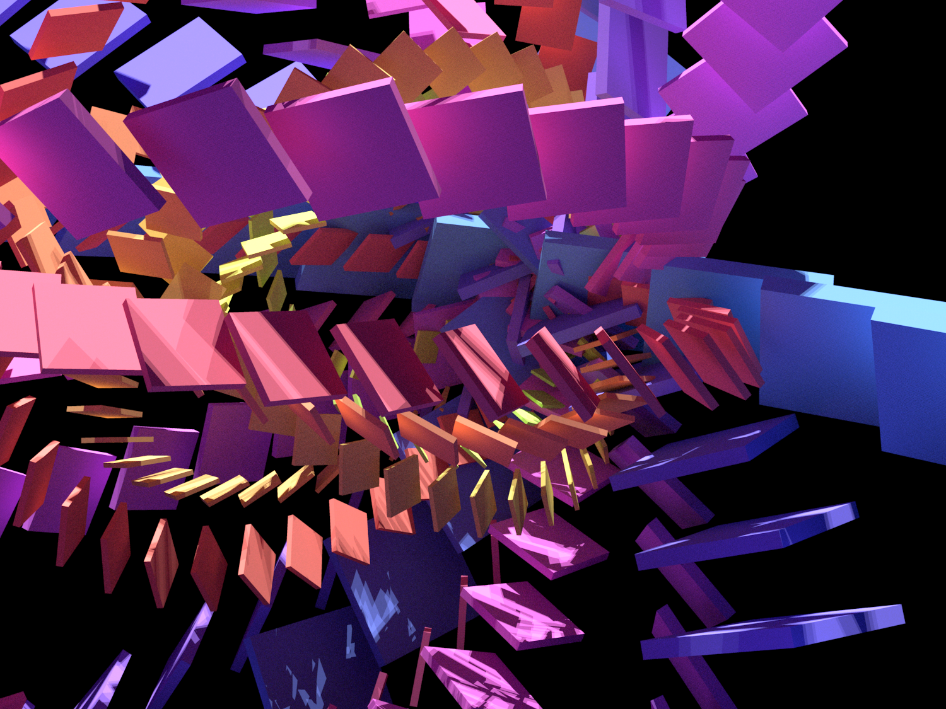

Slide 23
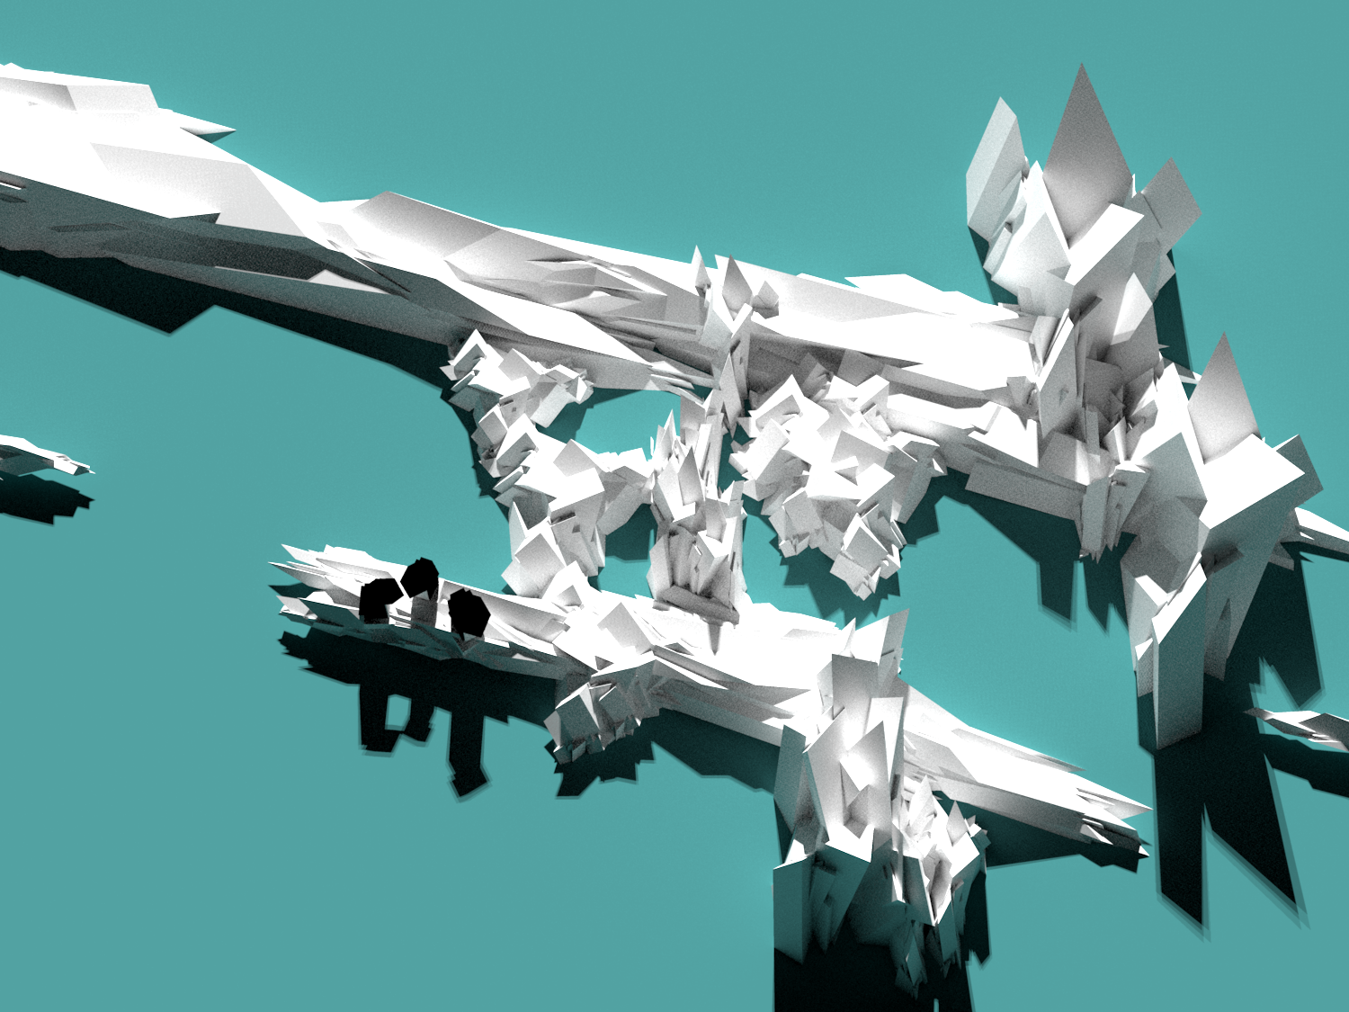

Slide 24
StructureSynth demo

Slide 25
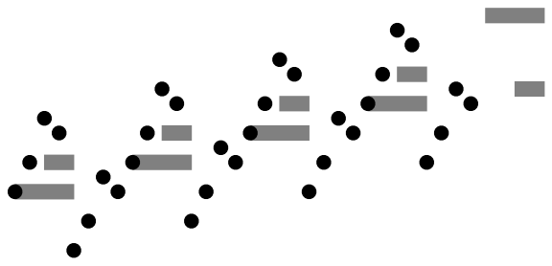

(define (bump)
(literal 1/2 '((0 3 0 1 1/2))))
(define (lump)
(after bump
(tra 2 bump)
(tra 4 bump)
(tra 5 bump)))
(define (string-step)
(literal 2 '((0 4 0 1 2)(1 4 7 1 1)(0 4 2 1 2))))
(define (string-end)
(literal 2 '((0 4 4 1 1)(1 4 -1 1 1))))
(define (song)
(choose (vol 2/3 string-end)
(tra +2 (after (during string-step
(after lump (tra -4 lump)))
song))))
(perform song 120 (pc:scale 0 'dorian))
startshape song
rule bump { CIRCLE {} }
rule lump { bump{x 0 y 0}
bump{x 1 y 2}
bump{x 2 y 5}
bump{x 3 y 4}}
rule stringStep { SQUARE{s 4 1 x 2 y 0}
SQUARE{s 2 1 x 3 y 2} }
rule stringEnd { SQUARE{s 4 1 x 2 y 4}
SQUARE{s 2 1 x 3 y -1} }
rule song {
stringStep{z -1 b 0.5}
lump{}
lump{x 4 y -4}
song{x 8 y 2} }
rule song 0.25 { stringEnd{z -1 b 0.5} }

Slide 26
Links
http://www.contextfreeart.org/
http://structuresynth.sourceforge.net/
http://impromptu.moso.com.au/
Me:
adam@adamsmith.as
@rndmcnlly

